Slide 1
Human resources slide 1
SWIFTY
ANALYTICS
Santhosh Arunagiri
Charles Hohl
Sarah Morris
Cheromaine Smith
Joshua Wiser

Slide 2
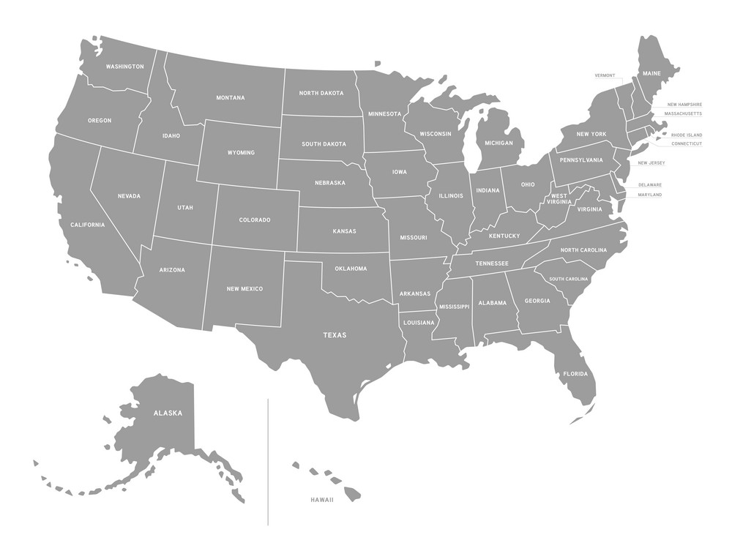



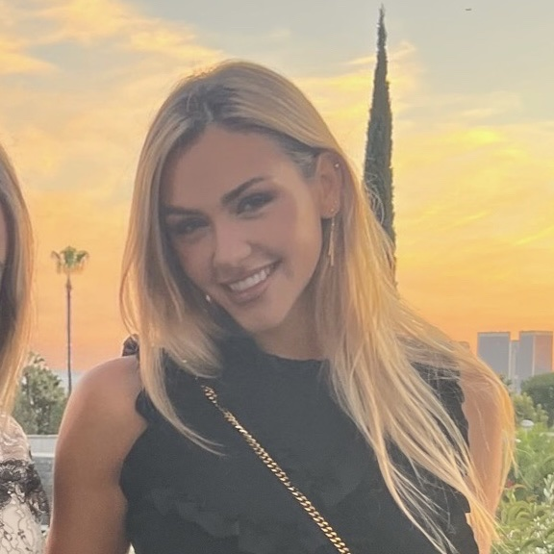

Human resources slide 9
Meet The Team
Our Team around the USA
Charles
Hohl
Joshua
Santhosh
Sarah
Cheromaine
Wiser
Arunagiri
Morris
Smith

Slide 3

Human resources slide 7
SPORTS
GAMBLING
39%
3%
91%
90%
Americans
Profitability
Applications
Winning

Slide 4
Human resources slide 5
MOTIVATION +
PROBLEM
STATEMENT
Data
Exploration
Given the increasingly easy access to sports gambling, there has been a growing demand for accurate winner predictions among the public.
As the game evolves, does the data also evolve in tandem with the changes happening in the game?
ANALYSIS
PLAN
Data
Cleansing
Machine
Learning
What factors are associated with which team wins or lose?
Is it possible to leverage advanced modeling and clustering techniques, to accurately predict the outcome of future games?

Slide 5
Human resources slide 2
AGENDA
Find rules associated with NFL game winners and losers
Identify patterns or correlations between winners and weather details as well as stadium conditions
Identify factors that aid in predicting game winner? Do we have all the necessary data?
Investigate whether machine learning algorithms can be used to accurately predict the probability of a team winning the game.

Slide 6
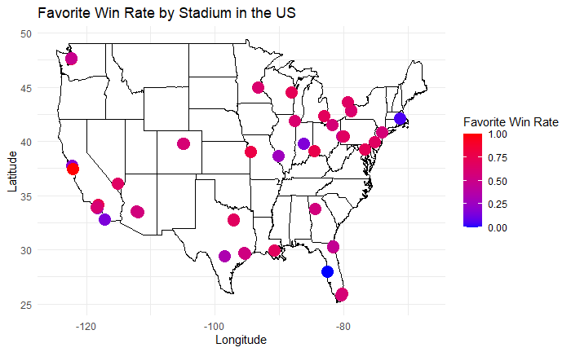
Human resources slide 6
EXPLORATORY DATA ANALYSIS – SCORES BY LOCATION

Slide 7
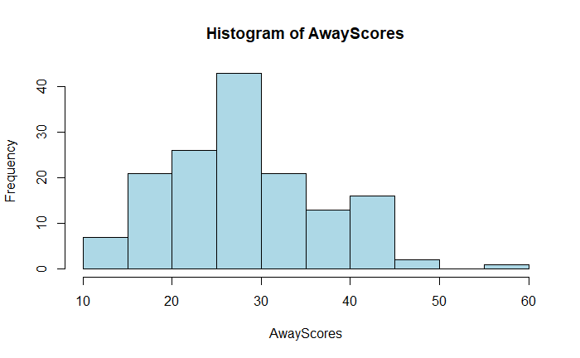
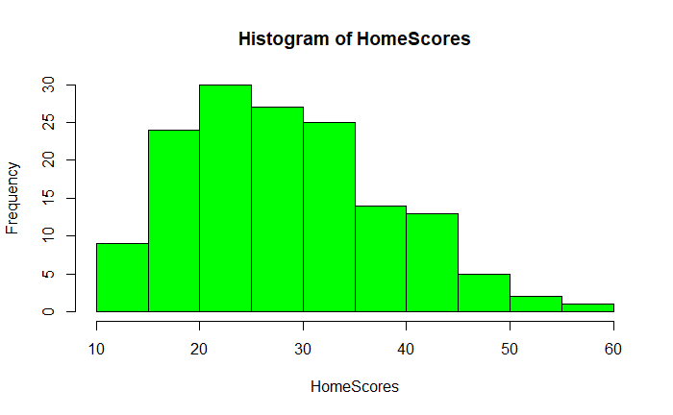
Human resources slide 6
EXPLORATORY DATA ANALYSIS – SCORES DISTRIBUTION

Slide 8
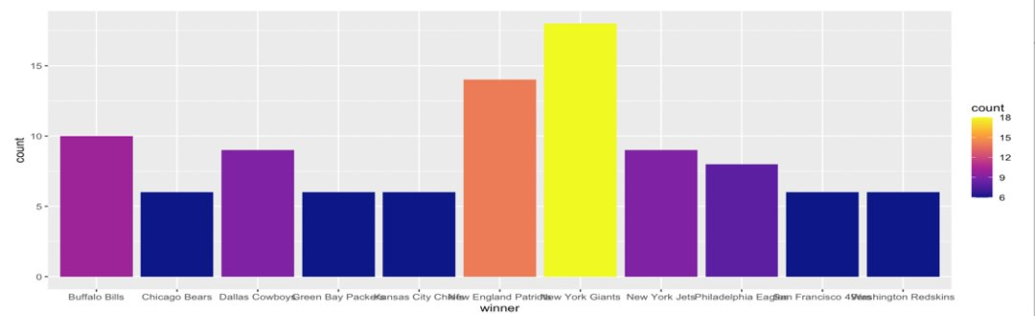
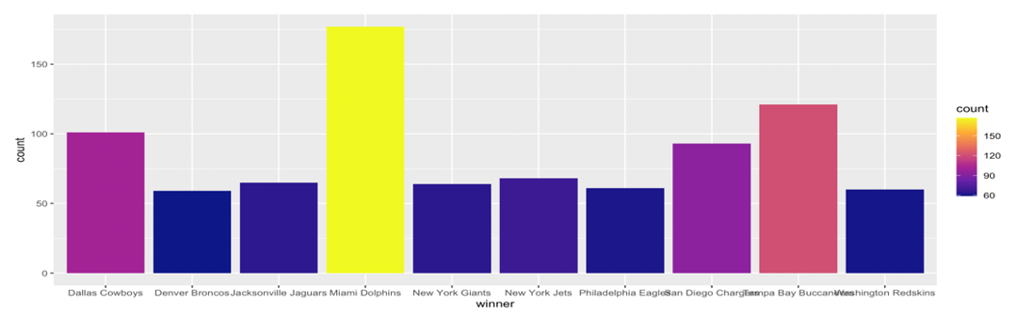
Human resources slide 6
EXPLORATORY DATA ANALYSIS – WEATHER
Most Wins in Windy Weather (>20mph)
Most Wins in Warm Weather (>65 degrees F)

Slide 9
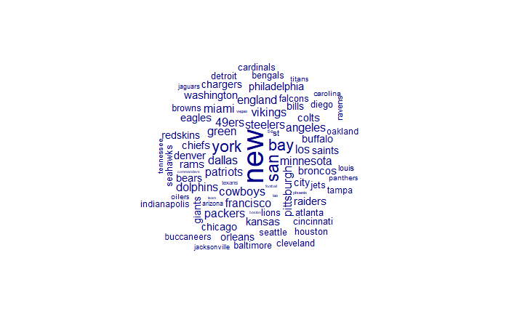
Human resources slide 6
EXPLORATORY DATA ANALYSIS WORD CLOUD

Slide 10
Human resources slide 4
DECISION TREE
CLUSTERING
SUPPORT VECTOR MACHINE
ASSOSCIATION
RULE
MINING
RANDOM FOREST
METHODS OF ANALYSIS

Slide 11

Human resources slide 3
Association
Rule
Mining
Association Rules for favorite_won=TRUE
Association Rules for favorite_won=FALSE
The San Francisco 49ers winning had a support of about 3.12% and confidence of 80.04%, indicating a relatively strong association with the favorite winning.
Games played at Candlestick Park with the San Francisco 49ers winning showed a higher confidence of 88.44% for the favorite winning, with a support of 1.56%.
The Minnesota Vikings winning at their home ground had a support of 1.73% and confidence of 82.28%, suggesting a favorable outcome for the favorite.
Green Bay Packers' victories at Lambeau Field had a strong association with the favorite winning, showing a confidence of 87.69%.
The rule involving the San Francisco 49ers and a spread favorite range of [-26.5,-6.5) demonstrated a very high confidence of 92.78%, though with a lower support of 1.59%.
Matches at Gillette Stadium are highly likely to result in the favorite not winning, despite a support of only 1.68%.
The Oakland Raiders winning was associated with the highest confidence of 98.46% for the favorite not winning, suggesting a strong tendency for upsets.
The Tennessee Titans, both as winners and home team, showed a significant association with the favorite not winning, with confidences above 84.61%.
The San Diego Chargers (Los Angeles Chargers), both as winners and home team, showed very high confidence levels (above 98%) in association with the favorite not winning.
The New England Patriots winning, both as a home and away team, had a very high confidence (above 98%) for the favorite not winning, indicating a strong propensity for overcoming odds.
Association Rule Mining analysis provided insights into the outcomes of games, revealing patterns and trends that influence whether the favorite teams win or lose. Examining specific team victories, game locations, and game conditions, strong associations were discovered that could help predict future game outcomes.

Slide 12
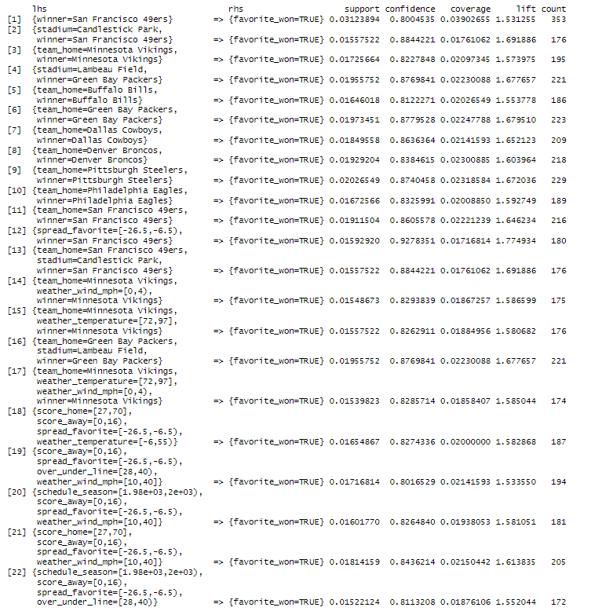
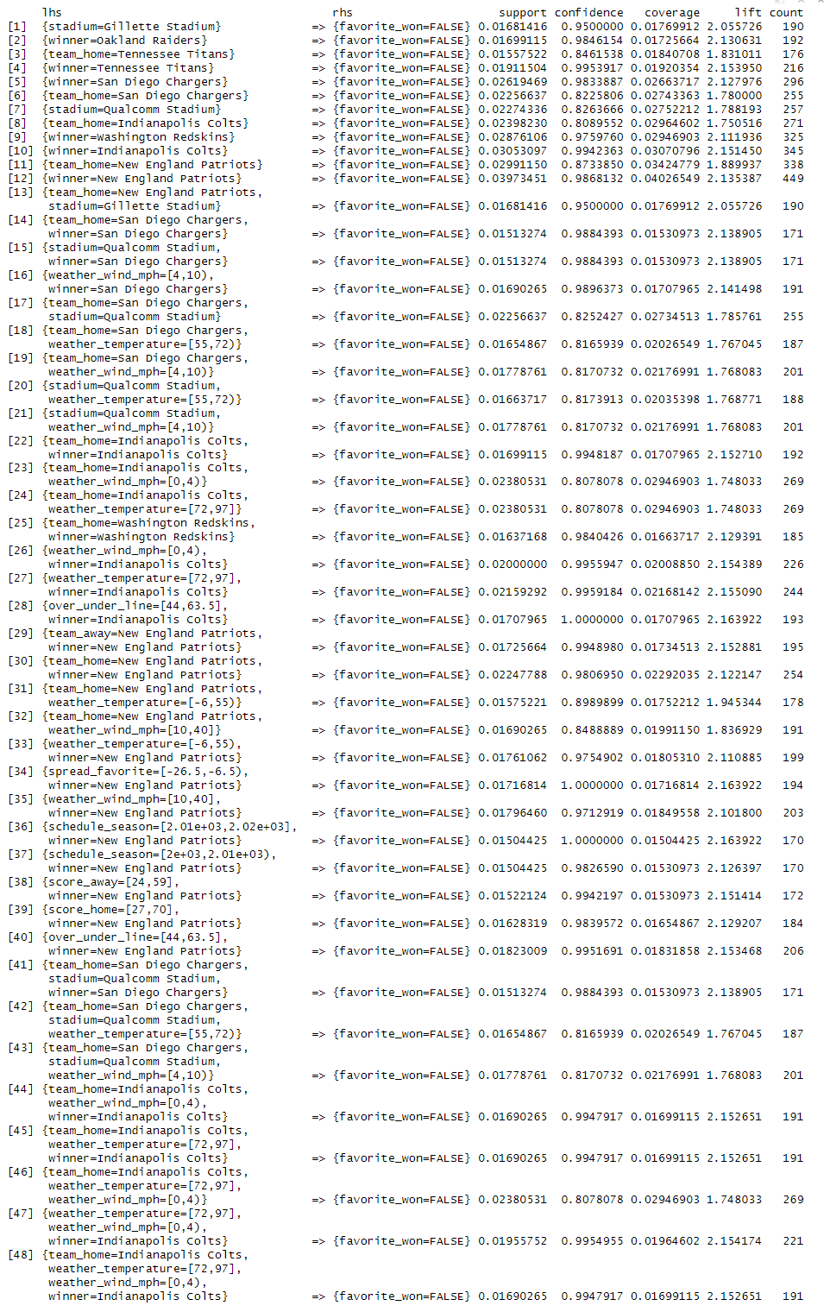
Human resources slide 3
Association Rule Mining
EMPLOYEES ARE MOTIVATED BY:

Slide 13
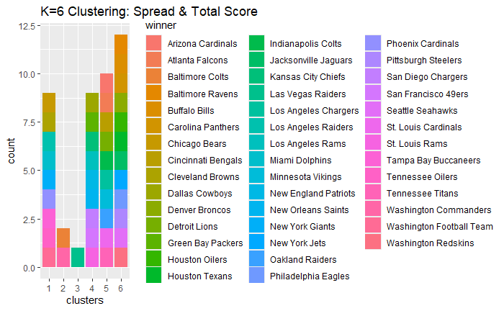

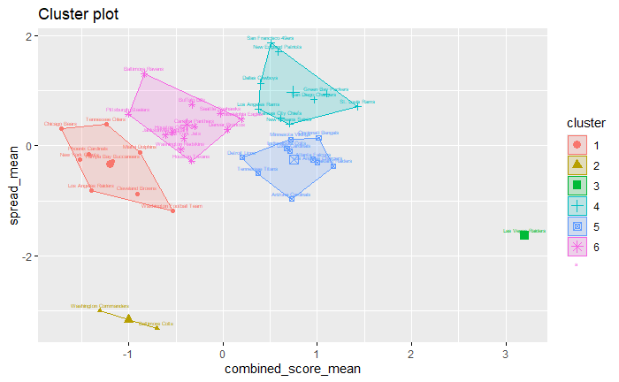
Human resources slide 8
K-Means Clustering
What patterns emerge when we cluster teams by spread and overall score?
Other than picking an outright favorite, there are two most common wagers placed on a game:
Point Spread (the number of points a team is expected to win by)
Total (also known as the over/under line: the combined score for the entire game)
By using K-Means clustering techniques and standardizing the mean overall score and spread for each winning team, patterns appear in the data that group teams into "clusters" according to their average game stats.
Cluster 4 teams (49ers, ) have the highest mean spread and combined score.
Cluster 2 teams have the lowest mean spread and mean score.

Slide 14
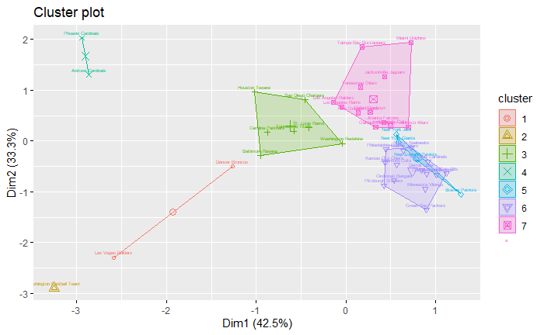
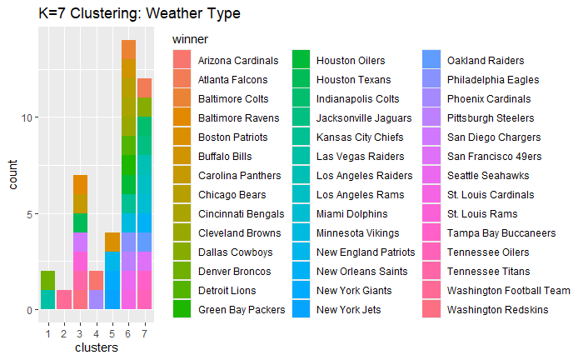
Human resources slide 8
K-Means Clustering
What patterns emerge when we cluster teams by weather type?
K-Means Clustering also reveals data about how teams perform in different weather types in relation to one another.
Teams in cluster 1 (Las Vegas and Denver) perform poor to average in high temperature, high humidity, and high wind speed.
Teams in cluster 7 (Miami Dolphins, Tampa Buccaneers, etc) perform very well in extreme weather conditions (high temperature, humidity, and windspeed).
Teams in cluster 4 (Arizona Cardinals) perform well in high temperature, but poorly in high windspeed and humidity.
Teams in cluster 6 (Buffalo Bills, KC Chiefs) perform better in high wind speed/humidity and more poorly in higher temperatures.

Slide 15
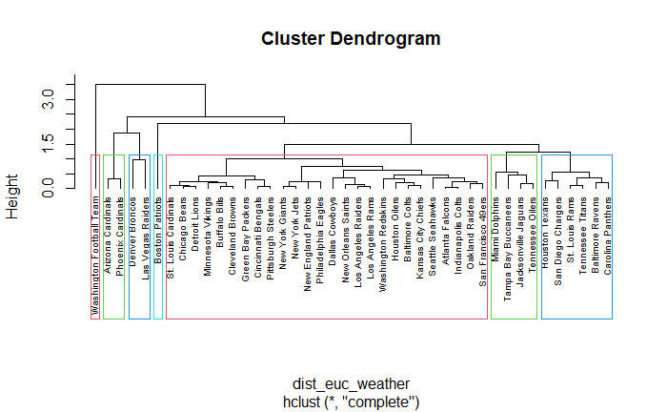
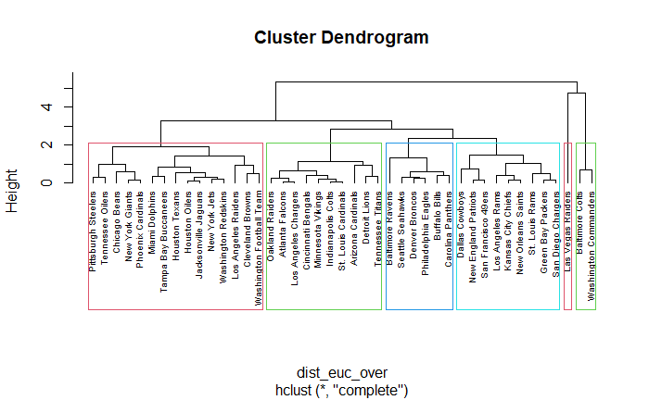
Human resources slide 8
HAC (Hierarchal Clustering)
Through calculating the euclidean distance between teams clustered closely together, we develop more insight into which teams perform most similar to each other.
The left dendrogram shows weather performance, while the right dendrogram shows spread and total score similarity.
Taking a closer look at hierarchal clustering of teams

Slide 16
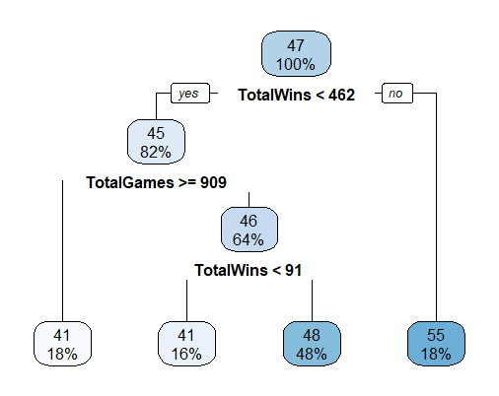
Human resources slide 6
DECISION TREE ANALYSIS

Slide 17
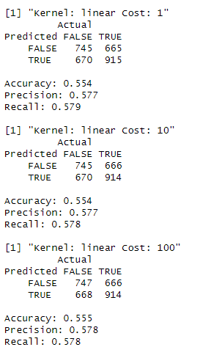
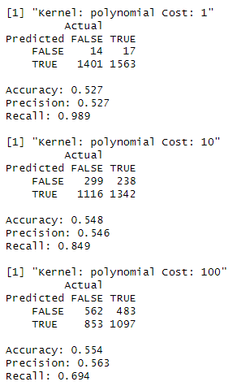
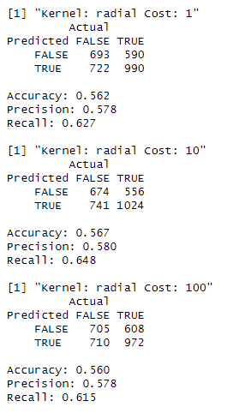
Human resources slide 5
SUPPORT VECTOR
MACHINE
Poly
Radial Basis Function w/ Cost 10 has best Performance
56.7% accuracy, 58% precision, 64.8% recall
Very High Recall (98.9%) for Polynomial Functions w/ Cost 1
Low accuarcy and precision
Very little variance among linear models
Average accuracy hovers around the 55% mark
SVM
Linear
Radial

Slide 18
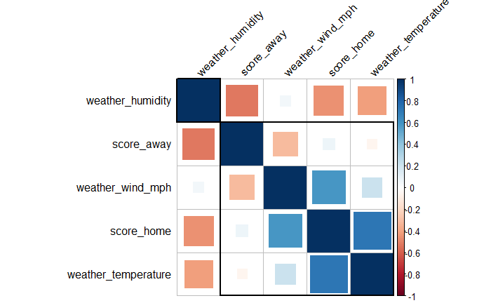
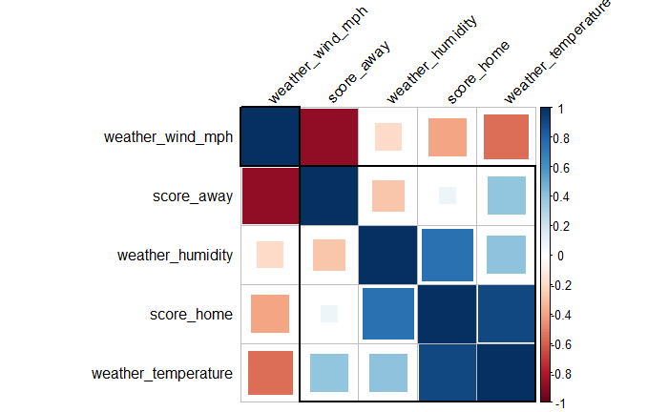

Human resources slide 8
CORRELATION & PREDICTIONS
Kansas City Games
Positive Relationships:
Temperature/ Home Score
Wind/Home Score
Negative Relationships:
Humidity/Away Score
Temperature/Wind
Little/No correlation:
Wind/Humidity
Away/Home Score
Kansas City Games Won
Who wins the 2024 Superbowl?
50%

Slide 19

Human resources slide 10
Thank You
As data evolves, we harness its potential to revolutionize the way we analyze and interpret the game, pushing the boundaries of what is possible.
.

